Slide 1


Vignesh G
13-01-2022

Slide 2

Outline
Executive Summary
Introduction
Methodology
Results
Conclusion
Appendix

Slide 3
Executive Summary
Methodology
Data Collection – SpaceX rest API
Data Wrangling – Python-Pandas
Exploratory Analysis – SQL, Pandas
Perform interactive visual analytics using Folium and Plotly Dash
Predicative Analysis- Sklearn-Classification (SVM, Decision Tree, Knn, Logistic regression)
Summary of result
Interactive Dashboard made with Plotly-Dash that helps with easy visual analysis
ML Model selection done to prediction if the first stage will land with 83.3% accuracy

Slide 4
Introduction
Project background and context
SpaceX advertises Falcon 9 rocket cost of 62 million dollars while other providers cost upward of 165 million dollars each, much of the savings is because SpaceX can reuse the first stage. Therefore, if we can determine if the first stage will land, we can determine the cost of a launch. This information can be used if an alternate company wants to bid against SpaceX for a rocket launch.
Problems find answers
Predict if the reusable first stage of the rocket will land or not.

Slide 5


Slide 6
Methodology
Data collection methodology:
Data was collected by using various SpaceX REST API endpoints (https://api.spacexdata.com/v4/)
Another source of data was obtained by web-scrapping Wikipedia (https://en.wikipedia.org/wiki/List_of_Falcon\_9\_and_Falcon_Heavy_launches) using beautiful soup
Perform data wrangling
Data wrangling was done using python to take care of missing values, performing one hot encoding and feature addition was done by merging results from multiple APIs
Perform exploratory data analysis (EDA) using visualization and SQL
Perform interactive visual analytics using Folium and Plotly Dash
Perform predictive analysis using classification models
The cleaned data was split into train and test data, different classification ML models like SVM, Decision Tree, Knn, Logistic regression were trained using the training data, GridSearchCV was used to find the optimum hyperparameter for each of the model and the accuracy score was computed for each of the model on the test data. The model with the highest test accuracy score is selected for the final prediction.

Slide 7
Data Collection
Rest API
Data was collected by using various SpaceX REST API endpoints (https://api.spacexdata.com/v4/)
Web Scrapping
Another source of data was obtained by web-scrapping Wikipedia (https://en.wikipedia.org/wiki/List_of_Falcon\_9\_and_Falcon_Heavy_launches) using beautiful soup

Slide 8
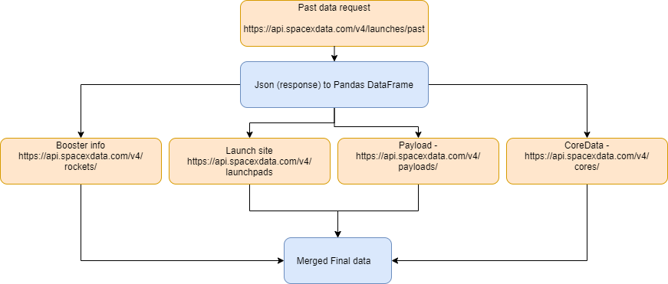
Data Collection – SpaceX API
The main data for the launch was collected using https://api.spacexdata.com/v4/launches/past
Feature addition to the main data was done requesting data from different APIs
Booster info https://api.spacexdata.com/v4/rockets/
Launch site - https://api.spacexdata.com/v4/launchpads/
Payload - https://api.spacexdata.com/v4/payloads/
CoreData - https://api.spacexdata.com/v4/cores/
Notebook link – Click here

Slide 9
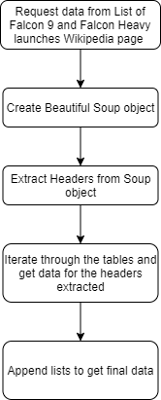
Data Collection - Scraping
Extract a Falcon 9 launch records HTML table from Wikipedia
Parse the table and convert it into a Pandas data frame
Notebook link – Click here

Slide 10
Data Wrangling
The data from multiple SpaceX APIs were merged to get the final dataset
The data was sliced for only the columns required for the analysis
Filtering was done for the following:
No of cores=1
No of payload=1
Booster version=Falcon1
Missing vales :
Payload mass – Missing values replaced with mean
Landing pad – Retain as None
Notebook link – Click here
You need to present your data wrangling process using key phrases and flowcharts
Add the GitHub URL of your completed data wrangling related notebooks, as an external reference and peer-review purpose

Slide 11
EDA with Data Visualization
Scatter plots used:
Payload vs Flight no – As flight no increases success rate increases
Launch site vs Flight no –
Launch site vs Payload - VAFB-SLC has a limit of 10,000 kg
Orbit vs payload – SSO has 100% success, Higher payloads of PO have 100% success
Bar Chart used:
Orbit vs Success mean – Success is highly dependent on type of orbit
Line chart used:
Year vs Success – Success increased with time, meaning newer launches are more successful
Notebook link – Click here

Slide 12
EDA with SQL
Displaying the names of the unique launch sites in the space mission
• Displaying 5 records where launch sites begin with the string 'KSC’
• Displaying the total payload mass carried by boosters launched by NASA (CRS)
• Displaying average payload mass carried by booster version F9 v1.1
• Listing the date where the successful landing outcome in drone ship was achieved.
• Listing the names of the boosters which have success in ground pad and have payload mass greater than 4000 but less than 6000
• Listing the total number of successful and failure mission outcomes
• Listing the names of the booster versions which have carried the maximum payload mass.
• Listing the records which will display the month names, successful landing outcomes in ground pad ,booster versions, launch site for the months in year 2017
• Ranking the count of successful landing outcomes between the date 2010-06-04 and 2017-03-20 in descending order
Notebook link – Click here

Slide 13
Build an Interactive Map with Folium
Mark all launch sites on a map using folium.map.Marker
Mark the success/failed launches for each site on the map – MarkerCluster()
Calculate distance between two points using haversine distance
Display the distance between two co-ordinates and mark the distance between them using a folium.polyline
Link to notebook – Check here

Slide 14
Build a Dashboard with Plotly Dash
Pie Chart
Pie Chart showing the total launches by a certain site/all sites
Display relative proportions of multiple classes of data.
Drop Down provided to select individual launch sit
Scatter Plot
Showing the relationship with Outcome and Payload Mass (Kg) for the different Booster Versions
A Slider is provided to alter payload

Slide 15
Predictive Analysis (Classification)
BUILDING MODEL
Load our dataset into NumPy and Pandas
Transform Data and Split our data into training and test data sets
Train different ML classification models on training data
Hyper parameter optimization is done using GridSearchCV applied on each model
EVALUATING MODEL
Prediction are made using the test data for each model
Accuracy score is calculated based on prediction and actual data of test data
Confusion matrix is plotted for each model
The model with the best accuracy score is selected
Link to notebook – Click here

Slide 16
Results
Exploratory data analysis results
Interactive analytics demo in screenshots
Predictive analysis results

Slide 17


Slide 18
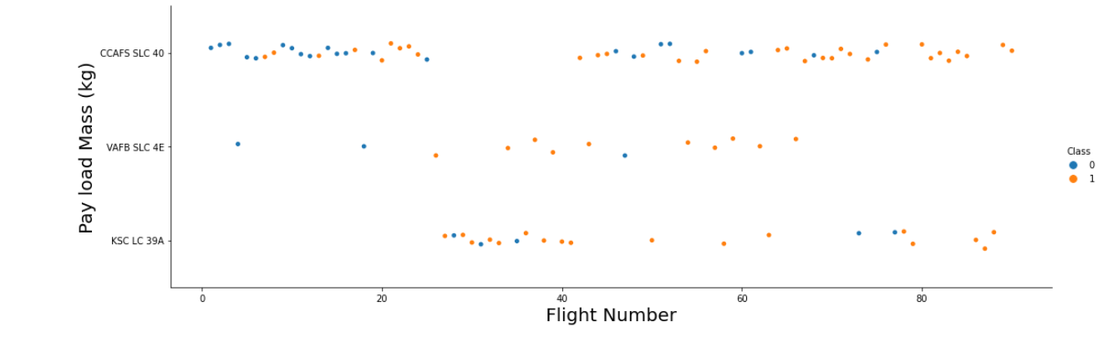
Flight Number vs. Launch Site
As the Flight number increased the success rate increases for all launch sites

Slide 19
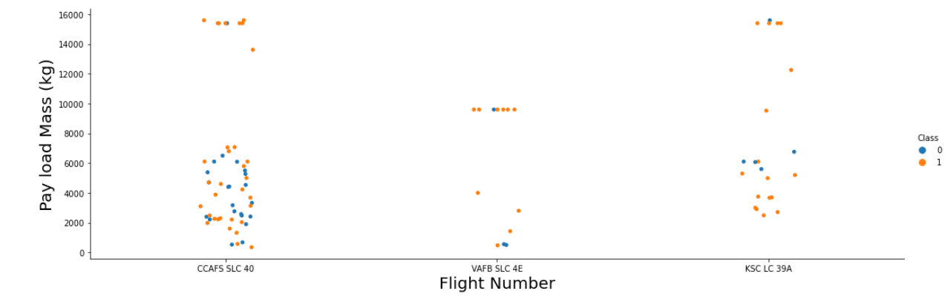
Payload vs. Launch Site
Payload Vs. Launch Site scatter point chart you will find for the VAFB-SLC launch site there are no rockets launched for heavy payload mass(greater than 10000).
Heavy payloads also tend to have a higher success rate

Slide 20
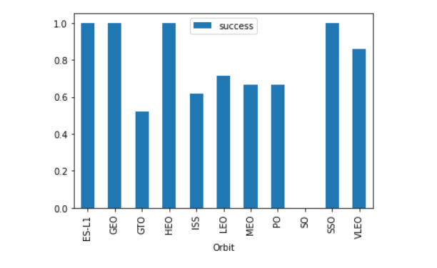
Success Rate vs. Orbit Type
Some orbits have 100% success rate

Slide 21
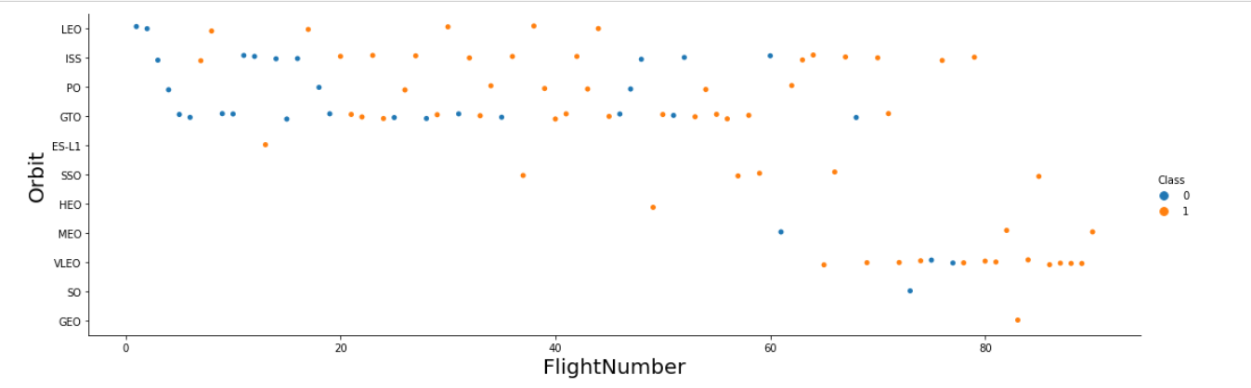
Flight Number vs. Orbit Type
You should see that in the LEO orbit the Success appears related to the number of flights; on the other hand, there seems to be no relationship between flight number when in GTO orbit.

Slide 22
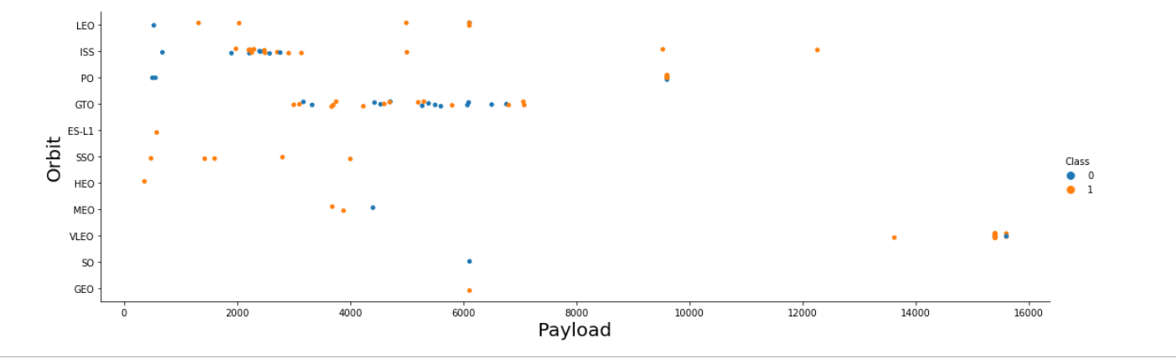
Payload vs. Orbit Type
With heavy payloads the successful landing or positive landing rate are more for Polar,LEO and ISS.
GTO we cannot distinguish this well as both positive landing rate and negative landing(unsuccessful mission) are both there here.

Slide 23
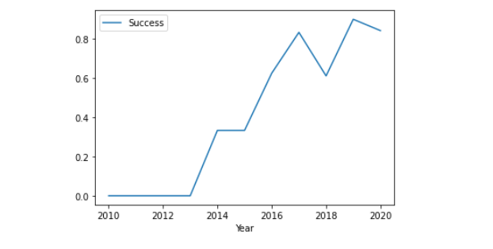
Launch Success Yearly Trend
There is a increasing trend in the success rate with time

Slide 24
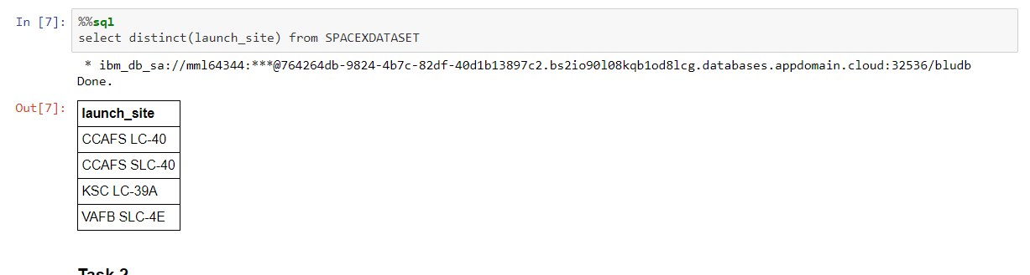
All Launch Site Names
Find the names of the unique launch sites

Slide 25
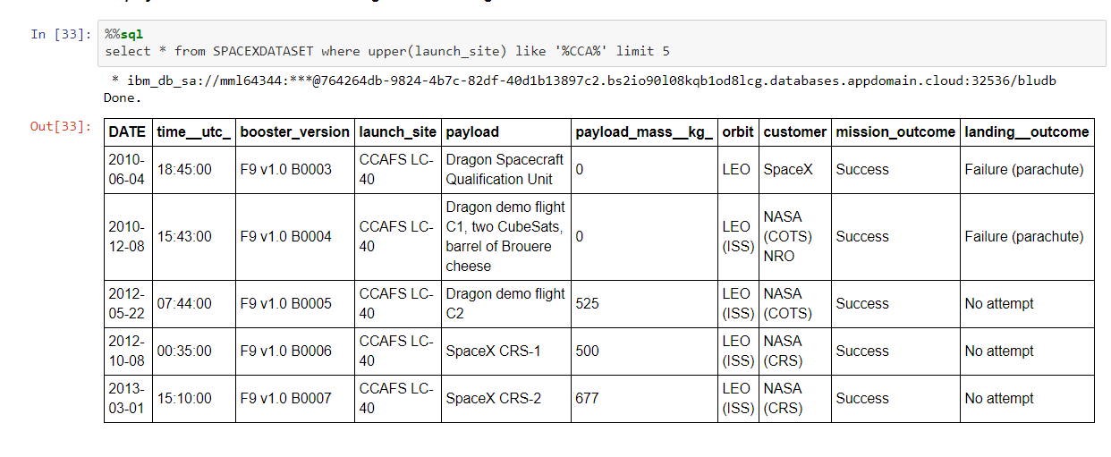
Launch Site Names Begin with 'CCA'
Find 5 records where launch sites begin with `CCA`

Slide 26
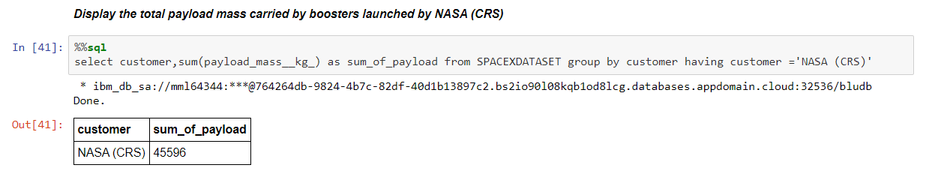
Total Payload Mass
Calculate the total payload carried by boosters from NASA

Slide 27
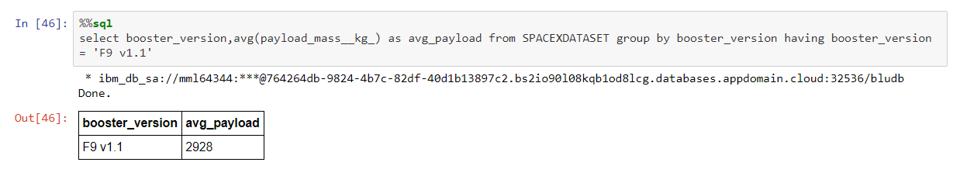
Average Payload Mass by F9 v1.1
Calculate the average payload mass carried by booster version F9 v1.1

Slide 28
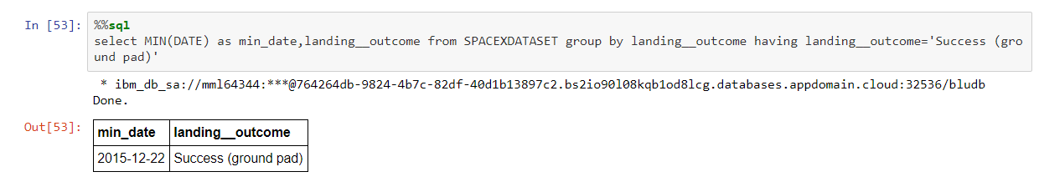
First Successful Ground Landing Date
Find the dates of the first successful landing outcome on ground pad

Slide 29
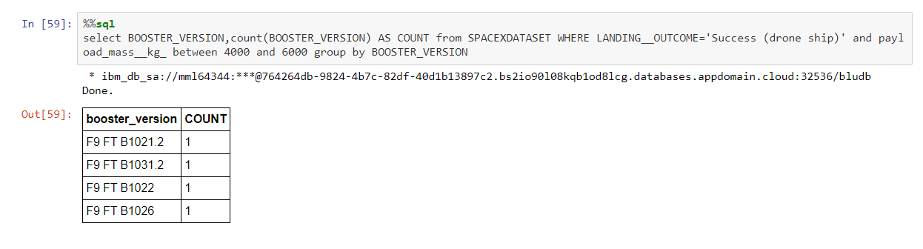
Successful Drone Ship Landing with Payload between 4000 and 6000
List the names of boosters which have successfully landed on drone ship and had payload mass greater than 4000 but less than 6000

Slide 30
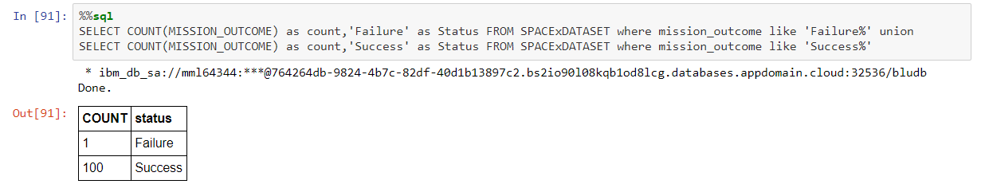
Total Number of Successful and Failure Mission Outcomes
Calculate the total number of successful and failure mission outcomes

Slide 31
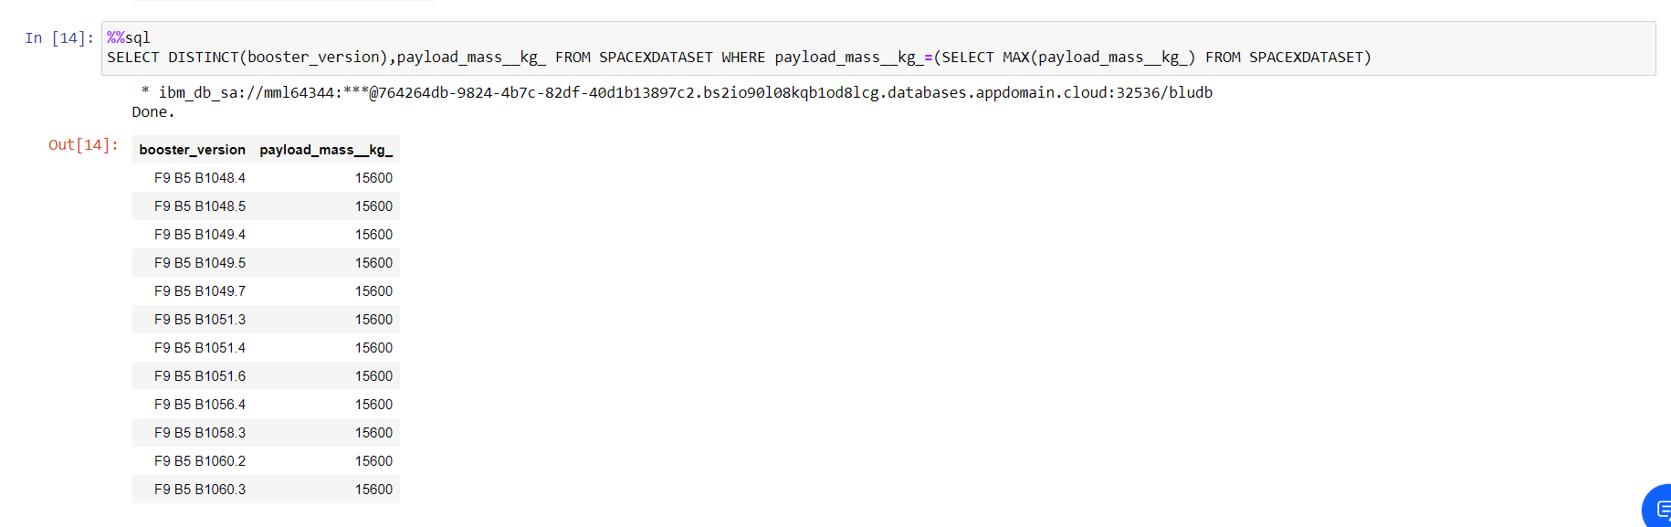
Boosters Carried Maximum Payload
List the names of the booster which have carried the maximum payload mass

Slide 32
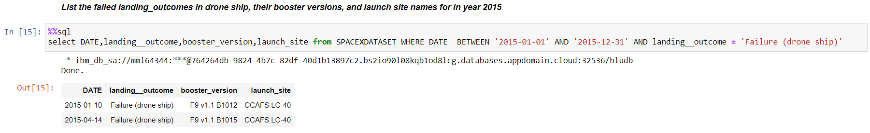
2015 Launch Records
List the failed landing outcomes in drone ship, their booster versions, and launch site names for in year 2015

Slide 33
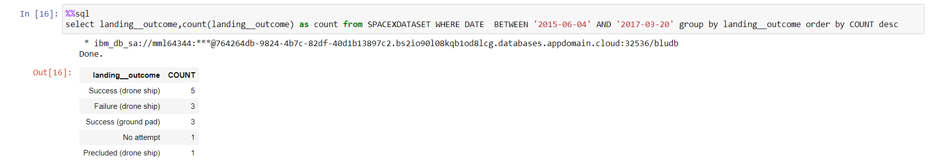
Rank Landing Outcomes Between 2010-06-04 and 2017-03-20
Rank the count of landing outcomes (such as Failure (drone ship) or Success (ground pad)) between the date 2010-06-04 and 2017-03-20, in descending order

Slide 34


Slide 35
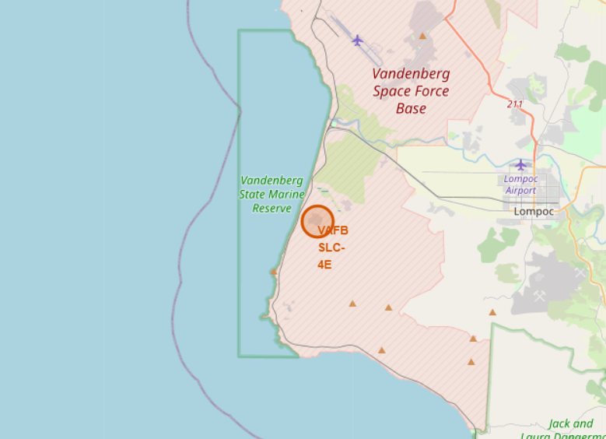
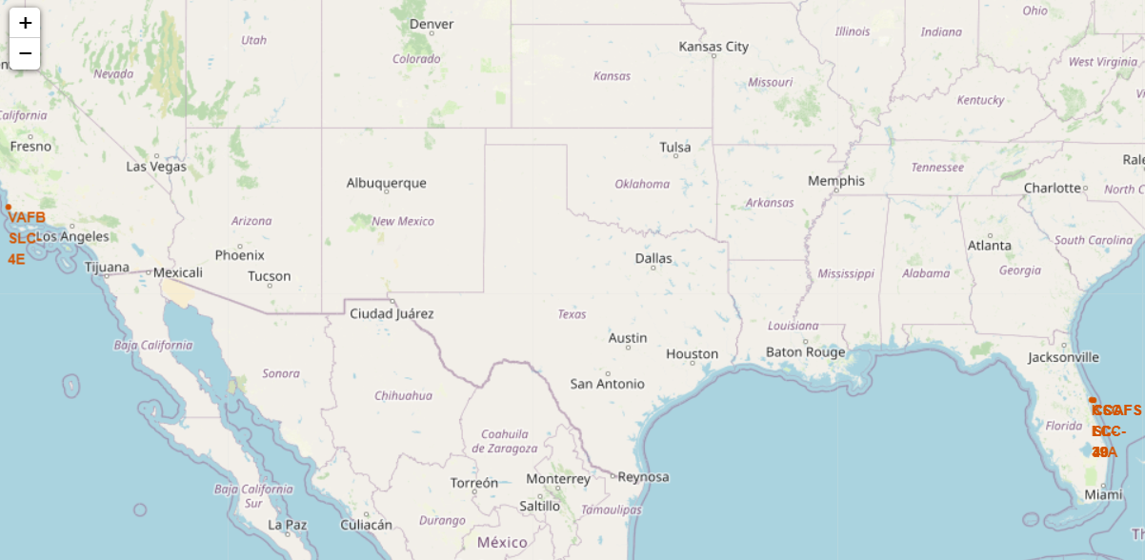
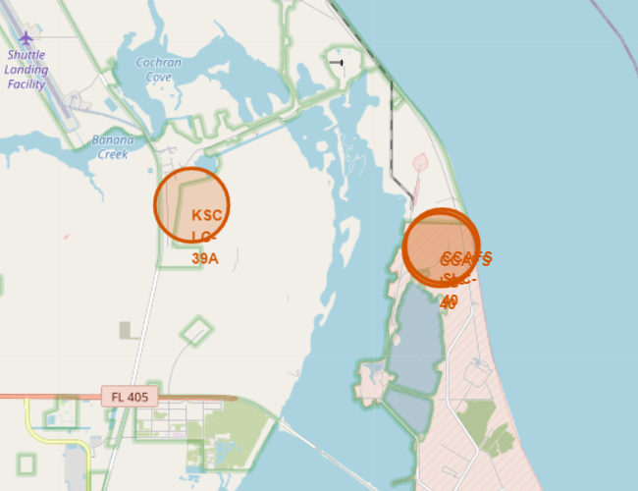
All launch sites
All launch sites are located near the coast

Slide 36
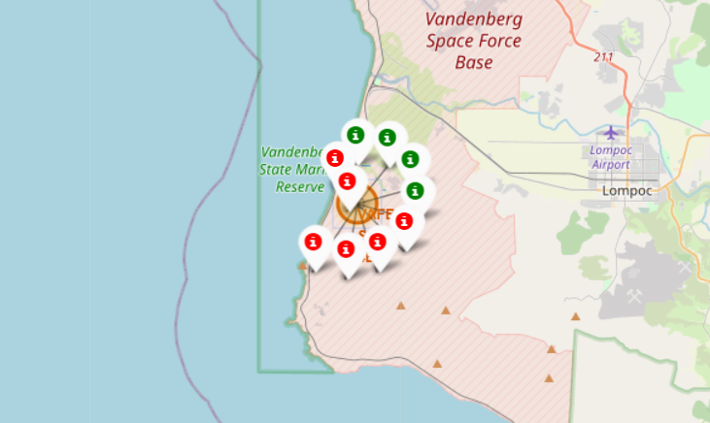
Outcome of launch

Slide 37
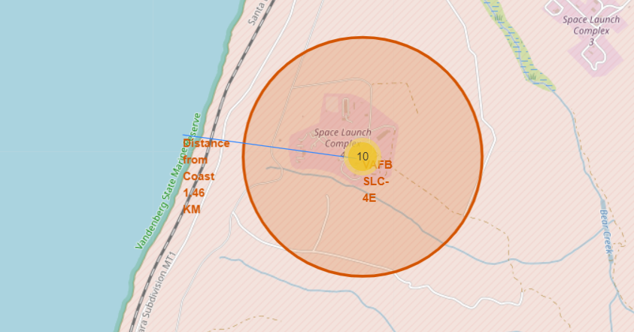
Proximity to coast

Slide 38


Slide 39
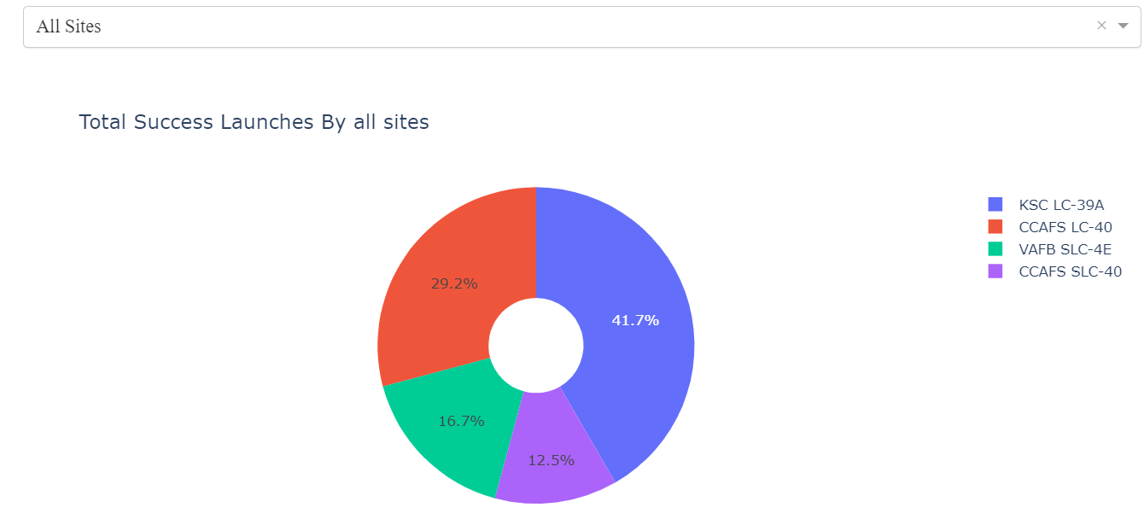
Pie chart showing the success percentage achieved by each launch site

Slide 40
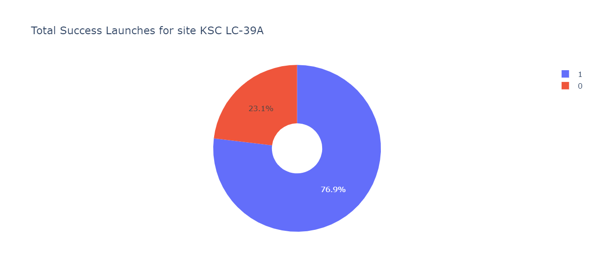
Pie chart for the launch site with highest launch success ratio

Slide 41
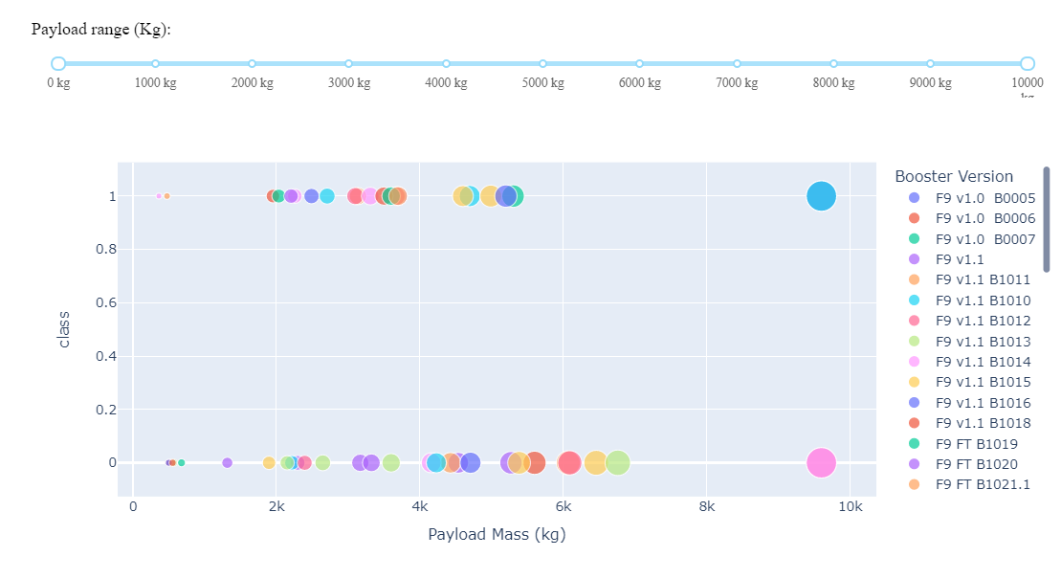
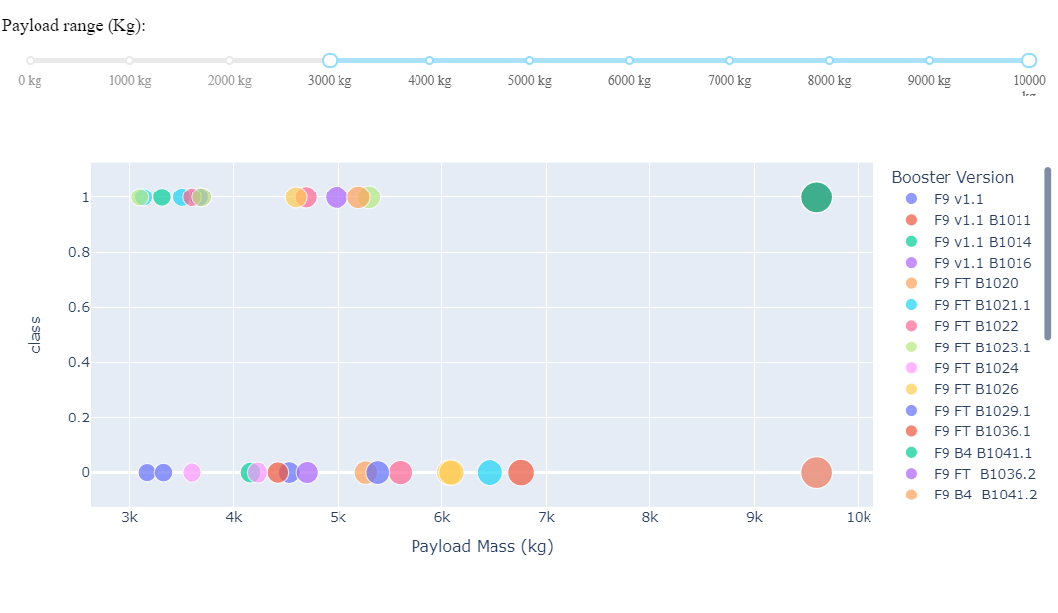
Payload vs. Launch Outcome scatter plot for all sites, with different payload selected in the range slider

Slide 42


Slide 43
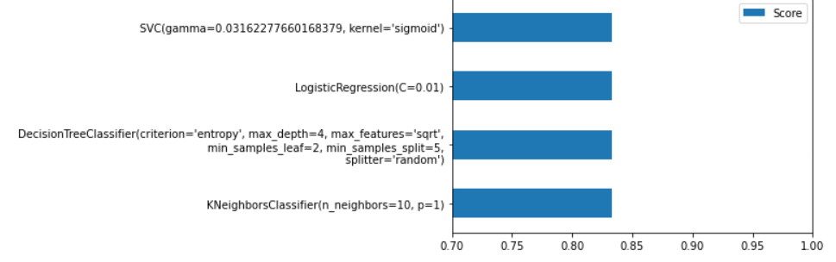
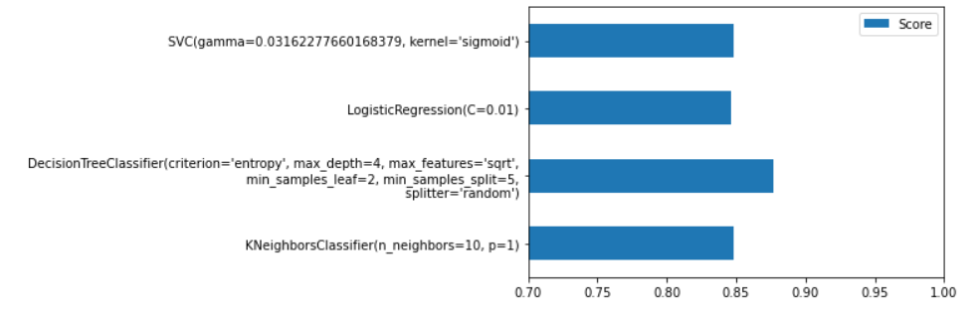
Classification Accuracy
Test Split
Train Split
All the models under consideration gave the same accuracy score on the testing dataset
Decision tree was selected as the final model due to slightly better performance on the training data (Decision tress is prone to overfitting yet for the sake of selection we will go ahead with it)

Slide 44
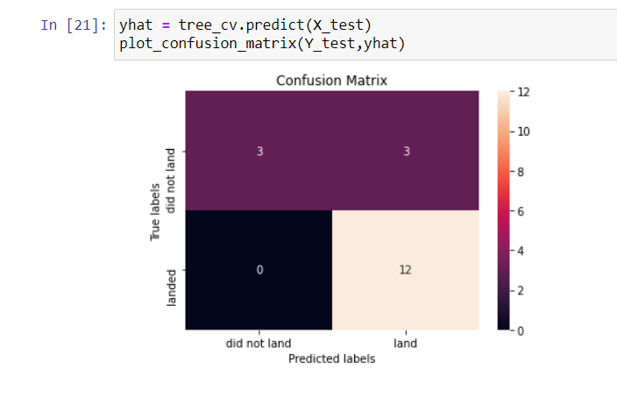
Confusion Matrix
Decision Tree confusion matrix

Slide 45
Conclusions
The Tree Classifier Algorithm is the best for Machine Learning for this dataset
The success rates for SpaceX launches increases proportionally with time suggesting that advances in technology and learning from past is key in increasing success rate
We can see that KSC LC-39A had the most successful launches from all the sites
Orbit GEO,HEO,SSO,ES-L1 has the best Success Rate

Slide 46
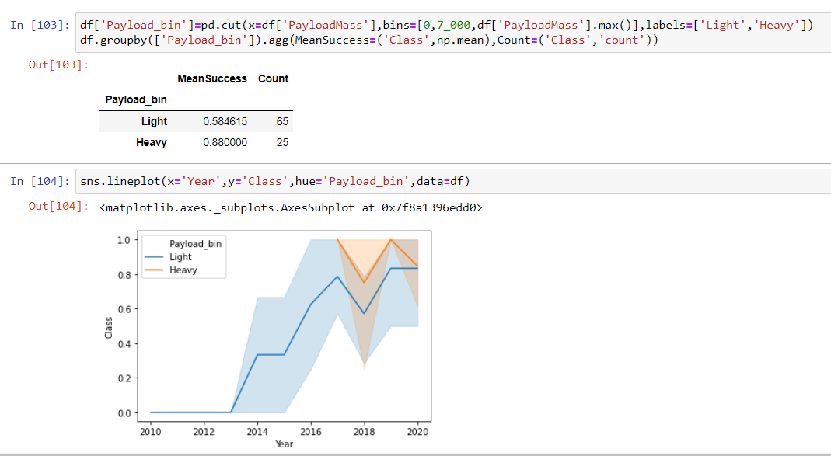
Appendix
Effect of Payload mass on success
Payload when considered alone suggests that heavier payloads(>7000kg) perform better but,
When we combine payload and year of launch the trend is not as convincing as higher payload launches started only on 2017 where the success rate of even lighter payload is almost the same during that time period .

Slide 47


